Slide 1
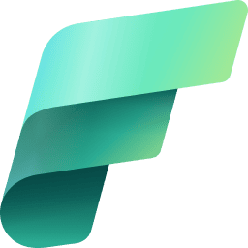
Microsoft Fabric

Slide 2
Problem Statements (What is Fabric Tryna solve?)
Fragmented Data Systems:
Organizations often struggle with siloed data scattered across various storage systems, databases, and applications, making it difficult to access and integrate.
Consolidating this data for analytics, reporting, or AI/ML purposes involves extensive effort and custom solutions.
High Cost of Data Infrastructure:
Maintaining separate tools and platforms for data integration, data lakes, analytics, and AI workloads leads to high infrastructure and operational costs.
Lack of Collaboration Across Teams:
Data, analytics, and AI teams often operate in silos, leading to misaligned efforts and wasted resources.

Slide 3
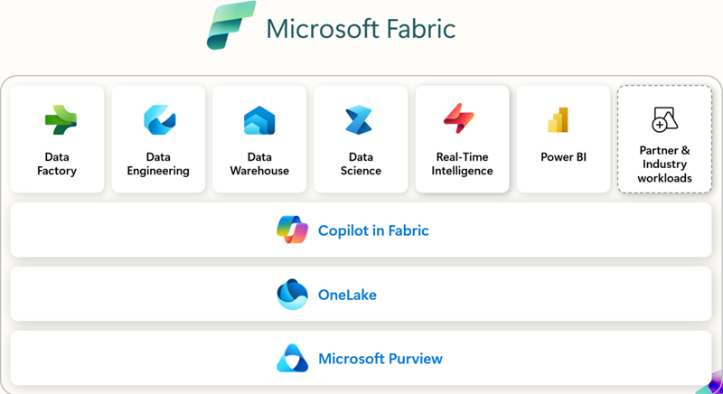
Unified Platform for Analytics and AI:
1) Microsoft Fabric integrates data engineering, data lakes, data science, analytics, and AI workloads into a single, end-to-end SaaS platform.
2) It reduces fragmentation by bringing all data capabilities under one roof.
Single Source of Truth
Copilot For Fabric ensures you get a beginner friendly experience and you use “AI for AI, by AI and with AI”
OneLake as a Unified Storage Solution: OneLake, the core of Microsoft Fabric, acts as a single, unified data lake for all data storage needs. There can never be zero and if you have fabric, you have one single ”OneLake” for your Fabric Tenant.
Collaboration and Governance: Built-in governance tools, such as Purview, ensure compliance, data lineage, and security.

Slide 4
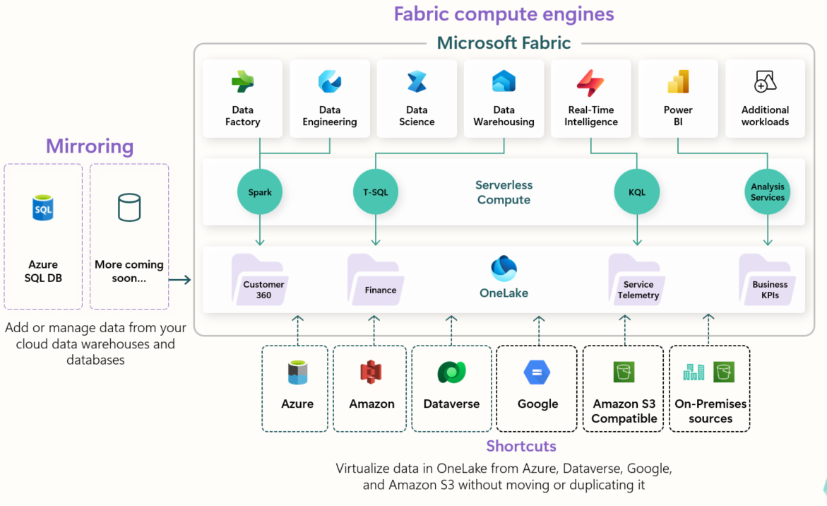
All the Microsoft Fabric compute experiences are prewired to OneLake, just like the Office applications are prewired to use the organizational OneDrive.
All the queries that you throw on your data run on a serverless starter pool which is in fact, “serverless” which means “cost saving” and “more focus on business workflow than infra”
OneLake is multi-cloud which means you can bring in data from “anywhere”, any CSP and that helps you establish a “single source of truth” for your entire organisation
You can use any engine to query your data stored in “OneLake”; doesn’t matter if you are a SQL developer, a data scientist whose comfortable with Python Apache Spark or even someone who works with real-time intelligent KQL queries – “Fabric’s got you covered!”

Slide 5
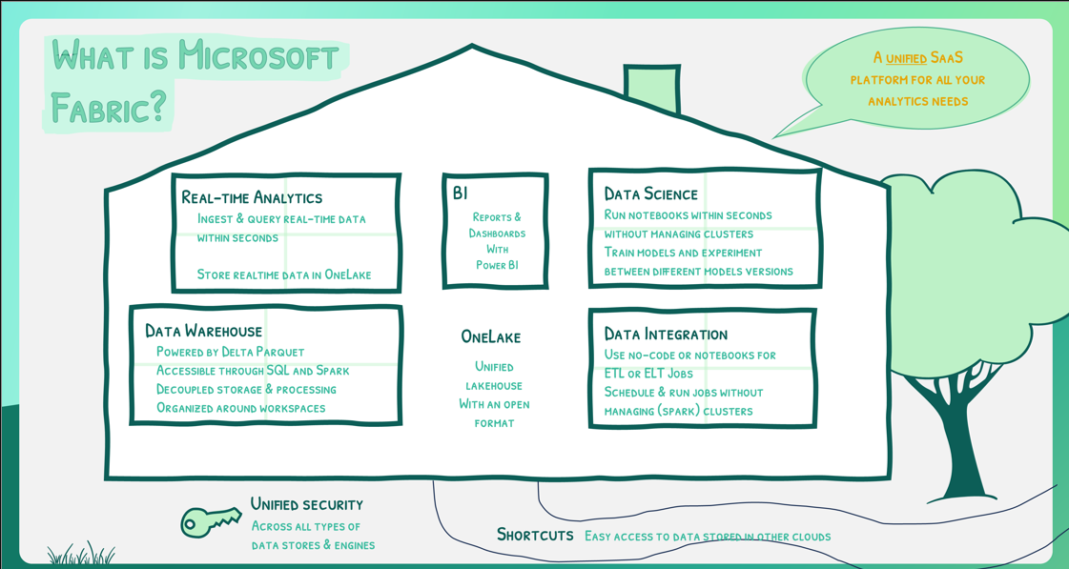

Slide 6
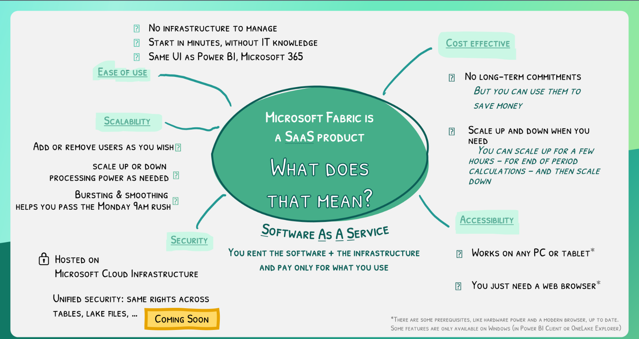
MS Fabric = SaaS Service (What does it mean?)

Slide 7
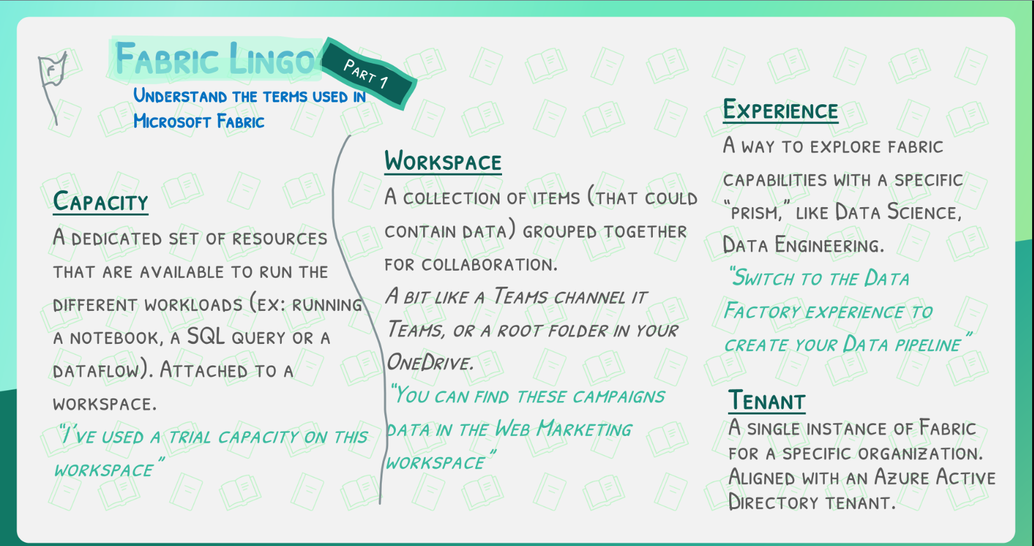

Slide 8
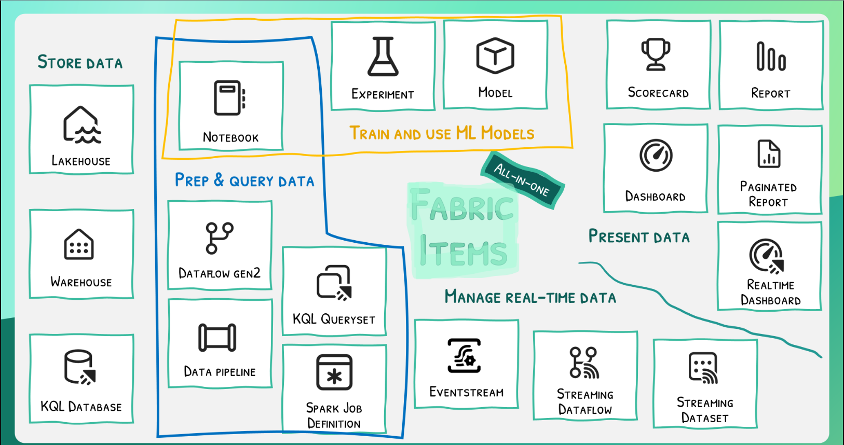
Notebook: An interactive workspace for data exploration, model development, and visualization.
Experiment: A tool for running and tracking machine learning experiments to optimize models.
Model: Enables training, deployment, and management of machine learning models.
Dataflow Gen2: A modern data preparation tool that supports complex transformations in a low-code environment.
Data Pipeline: Orchestrates ETL workflows to automate data integration processes.
KQL Queryset: Allows interactive exploration of telemetry and log data with KQL.
Spark Job Definition: Defines distributed data processing and analytics tasks using Apache Spark.
Lakehouse: Combines data lake and data warehouse capabilities for scalable data storage and querying.
Warehouse: A SQL-based data warehouse optimized for analytics and reporting.
KQL Database: Stores and queries telemetry data efficiently using Kusto Query Language.

Slide 9
Eventstream: Captures and processes real-time event data for analytics or alerting.
Streaming Dataflow: Processes streaming data with real-time transformations and analytics.
Streaming Dataset: Provides a live data feed for building real-time dashboards and reports.
Scorecard: Tracks key metrics and KPIs with visual goal-setting capabilities.
Report: Enables creation of paginated or interactive reports for sharing insights.
Dashboard: A visual interface for monitoring and interacting with live data.
Paginated Report: Generates fixed-format, print-ready reports for professional documentation.
Realtime Dashboard: Monitors live metrics and events with instantaneous updates.

Slide 10
